Slide 2
What could we learn
from Deno’s architecture?
陈天

Slide 3
Core concepts before we start
Introduction
v8 is the javascript runtime that sits in your chrome browser to execute the code in every web page
v8 isolate is a sandbox to run JS code in a secure and constrained environment (every chrome tab starts a new v8 isolate)
v8 bindings are the external references provided to v8 so that JS code can execute APIs provided by native side - e.g. if you do a TCP listen in JS, which will call something like an “op_listen” from C++ code.
promise is a value that could be resolved (or rejected) in a future time
async/await is syntactic sugar for using promise in “blocking”, non-callback manner

Slide 4
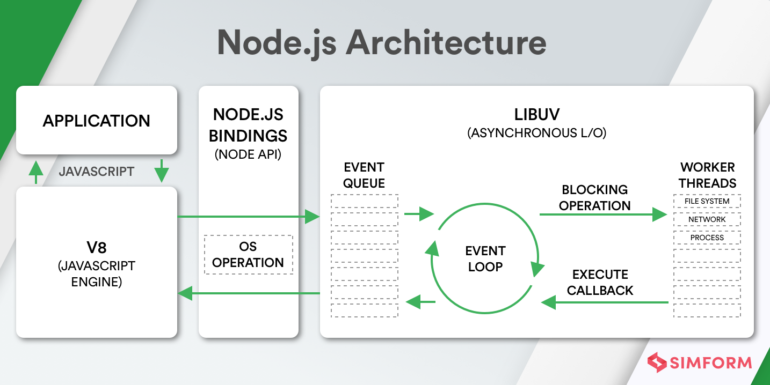
Architecture of Nodejs
Introduction
V8 as the JS execution engine
Node bindings to provide the server side operations for JS code
Libuv to handle the event loop for resolving promises (callbacks)
Libio to handle thread pool
Stdlib as a common foundation for user applications.
Source
Source: Fundamentals of Software Architecture

Slide 5
The problems of Architecture of Nodejs
Introduction
Security is totally neglected - nodejs code has all the power as other server-side code, regardless the great security provided by v8 engine
it is a big shame that nodejs app need to be containerized when v8 isolate itself is a sandbox
the bindings could have been built with fine-grained permission system while not
No clean separation
adding/removing operations is hard if you’re not a node core developer (or at least good C++/v8 eng)
cannot easily just grab part of the node core and use it as a building block to wrap your own engine
Source
Source: Fundamentals of Software Architecture

Slide 6
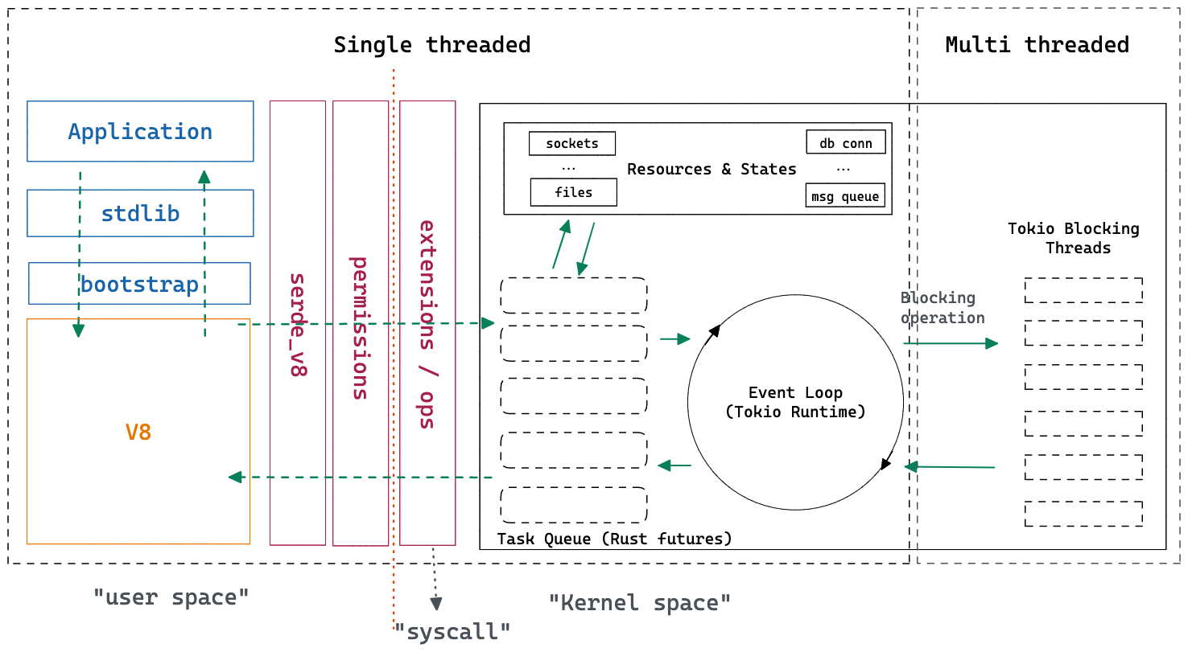
So, how deno solved this?
Introduction

Slide 7
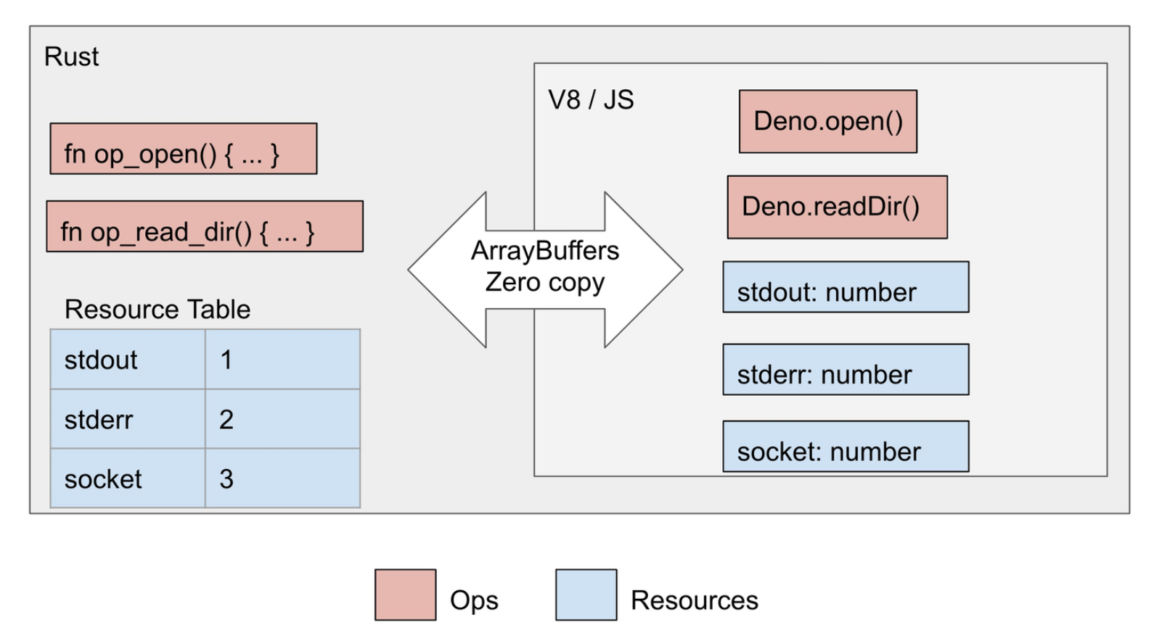
extension/ops: Reconcept v8 bindings to “syscall”
How deno solved this?
In computing, a system call (commonly abbreviated to syscall) is the programmatic way in which a computer program requests a service from the kernel of the operating system on which it is executed. This may include hardware-related services (for example, accessing a hard disk drive or accessing the device's camera), creation and execution of new processes, and communication with integral kernel services such as process scheduling. System calls provide an essential interface between a process and the operating system. - wikipedia
Concept-wise, it has a strong implication now
syscall will be added cautiously
3rd party cannot just randomly add a new syscall without your awareness
It has its own clearly defined layer
adding metrics / permissions / etc. a lot easier
rid vs fd, just as ops vs syscall

Slide 8
Let’s write a “hello world” bindings for node and deno
How deno solved this?
#include <node.h>
namespace demo {
using v8::FunctionCallbackInfo;
using v8::Isolate;
using v8::Local;
using v8::Object;
using v8::String;
using v8::Value;
void Method(const FunctionCallbackInfo<Value>& args) {
Isolate* isolate = args.GetIsolate();
args.GetReturnValue().Set(String::NewFromUtf8(
isolate, "world").ToLocalChecked());
}
void Initialize(Local<Object> exports) {
NODE_SET_METHOD(exports, "hello", Method);
}
NODE_MODULE(NODE_GYP_MODULE_NAME, Initialize)
} // namespace demo
// Rust code (“kernel space”)
#[op]
fn op_hello(name: String) -> String {
format!(“Hello {name}”)
}
// JS bootstrap code (“user space”)
((window) => {
function hello(name) {
return Deno.core.opSync(“op_hello”, name);
}
window.hello = hello;
})(this);
source

Slide 9
permissions: Make javascript(server) safe to run again
How deno solved this?
pub struct Permissions {
pub read: UnaryPermission<ReadDescriptor>,
pub write: UnaryPermission<WriteDescriptor>,
pub net: UnaryPermission<NetDescriptor>,
pub env: UnaryPermission<EnvDescriptor>,
pub run: UnaryPermission<RunDescriptor>,
pub ffi: UnaryPermission<FfiDescriptor>,
pub hrtime: UnitPermission,
}
pub struct UnaryPermission<T: Eq + Hash> {
pub name: &'static str,
pub description: &'static str,
pub global_state: PermissionState,
pub granted_list: HashSet<T>,
pub denied_list: HashSet<T>,
pub prompt: bool,
}
pub struct ReadDescriptor(pub PathBuf);
pub struct WriteDescriptor(pub PathBuf);
pub struct NetDescriptor(pub String, pub Option<u16>);
Permission layer limits the behavior of syscall
if user didn’t “allow-net”, “op_listen” would fail
By default, no permissions granted
meaning you can only do computational JS
One could build a RBAC on top of this
admin user’s script can do read/write/net for *
standard user’s script can do read/write/net for xyz

Slide 10
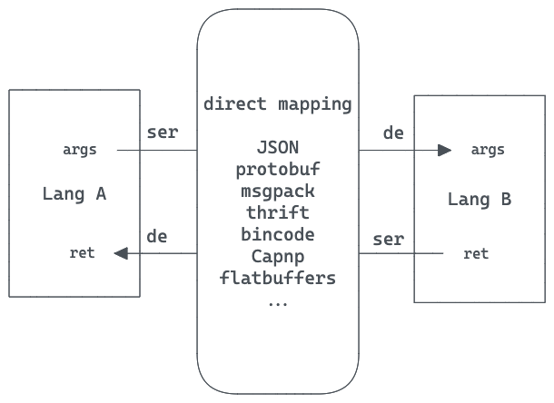
serde_v8: A common serialize/deserialize layer
How deno solved this?
What ser/de approach to choose?
Does it need to be cross network?
Could ser/de be hidden from users?
or at least make it as easy to use as possible
Could the ser/de functionalities be replaceable?
e.g. JSON is too inefficient I want to switch to binary format like bincode, is that possible without caller know?

Slide 11
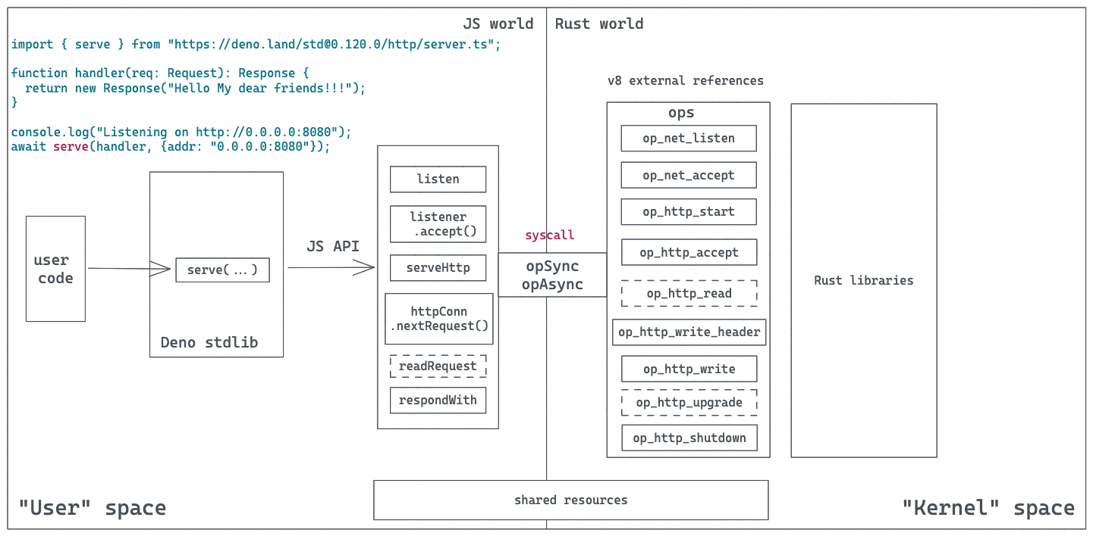
An example of how deno code executes
How deno solved this?

Slide 12
Why Rust?
What’s the benefit for using Rust?

Slide 13
Rust releases the potential
How deno solved this?
pub struct Permissions {
pub read: UnaryPermission<ReadDescriptor>,
pub write: UnaryPermission<WriteDescriptor>,
pub net: UnaryPermission<NetDescriptor>,
pub env: UnaryPermission<EnvDescriptor>,
pub run: UnaryPermission<RunDescriptor>,
pub ffi: UnaryPermission<FfiDescriptor>,
pub hrtime: UnitPermission,
}
pub struct UnaryPermission<T: Eq + Hash> {
pub name: &'static str,
pub description: &'static str,
pub global_state: PermissionState,
pub granted_list: HashSet<T>,
pub denied_list: HashSet<T>,
pub prompt: bool,
}
pub struct ReadDescriptor(pub PathBuf);
pub struct WriteDescriptor(pub PathBuf);
pub struct NetDescriptor(pub String, pub Option<u16>);
Permission layer limits the behavior of syscall
if user didn’t “allow-net”, “op_listen” would fail
By default, no permissions granted
meaning you can only do computational JS
One could build a RBAC on top of this
admin user’s script can do read/write/net for *
standard user’s script can do read/write/net for xyz

Slide 14
Learnings
What do we learn from node -> deno rearchitecture?

Slide 15
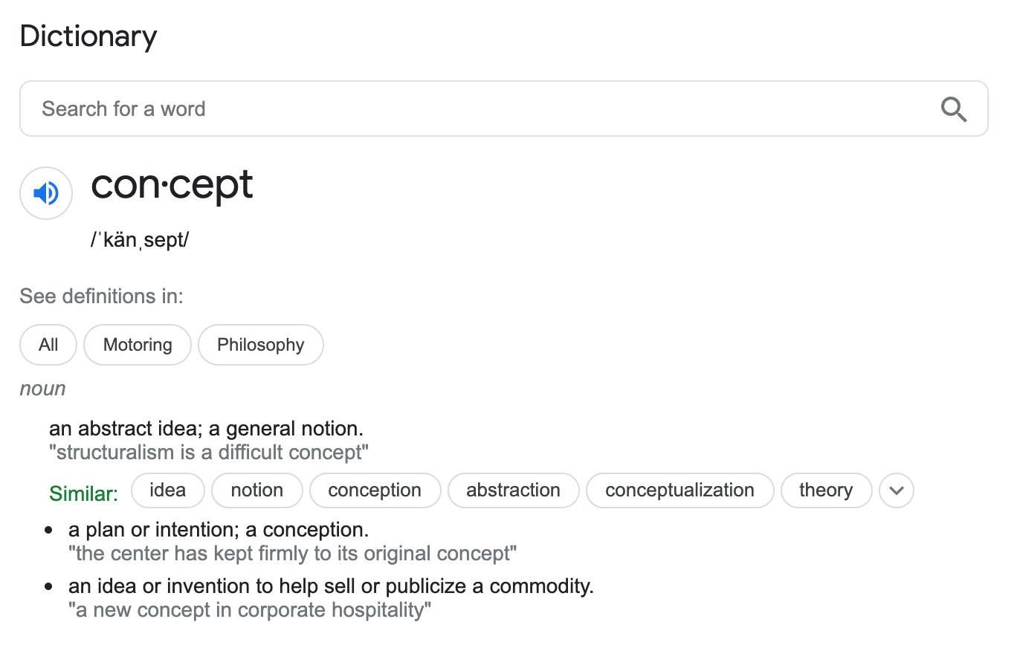
Architecture is about concepts
Software Architecture
Why concepts are important?
lots of bugs are caused by “misconception”
good concepts: pipe，stream，flow，socket
What are the core concepts in your system?
How do you define them?
What are their behaviors and restrictions?
What are their relationships?

Slide 16
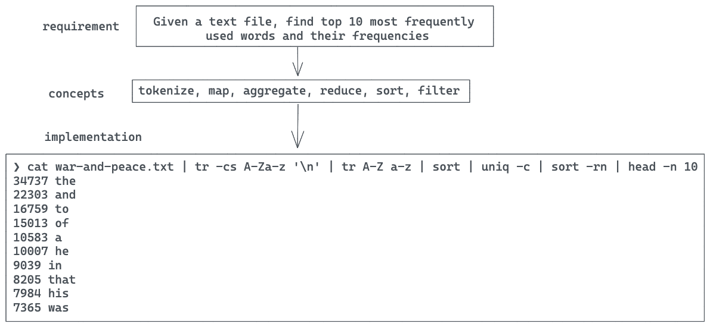
Architecture is about concepts (cont.)
Software Architecture
txt file of war and peace

Slide 17
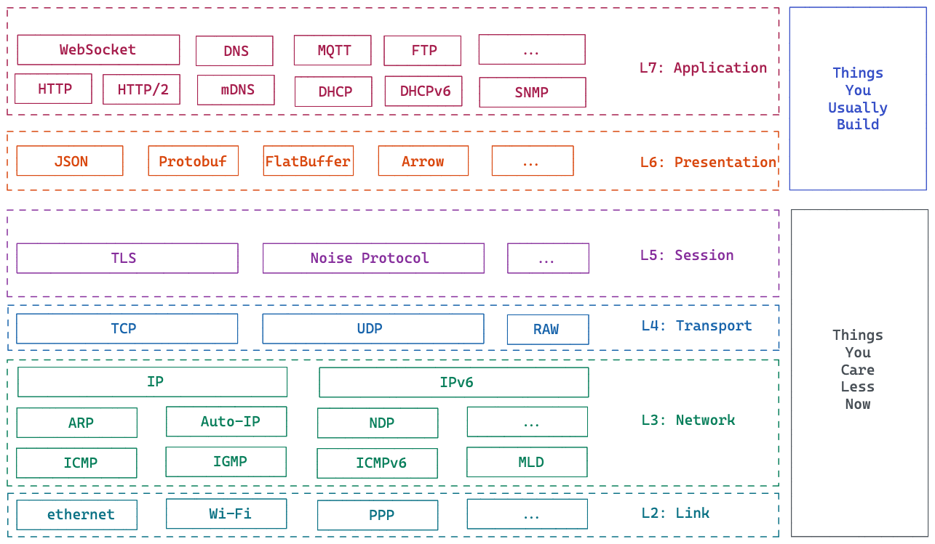
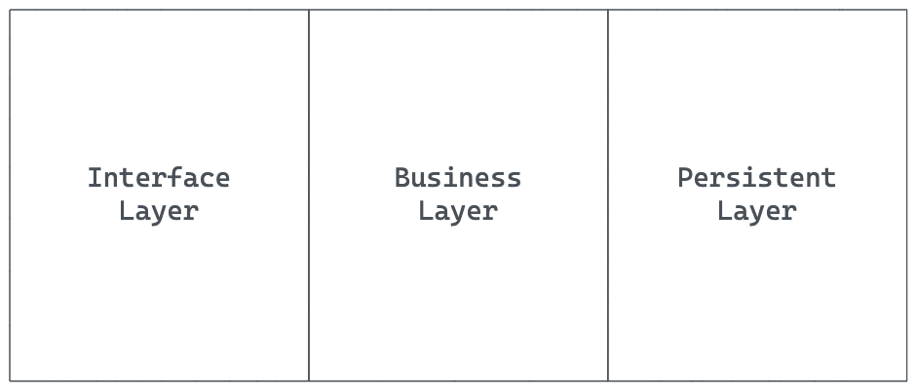
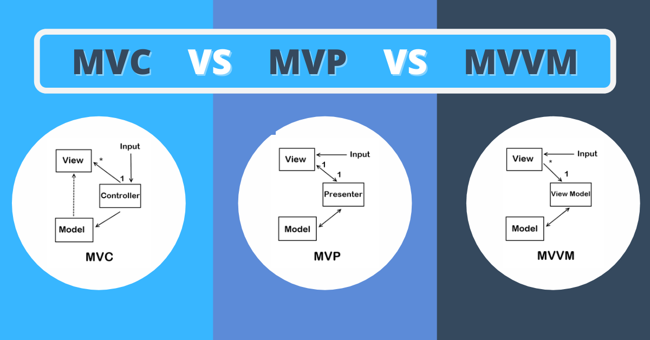
Thinking in Layers
Software Architecture
All problems in computer science can be solved by another level of indirection. - fundamental theorem of software engineering
source

Slide 18
Thinking in Layers(cont.)
Software Architecture
Why do we need a new layer?
for security purpose? For decoupling purpose? For separation of concerns? etc.
How to define layers?
get the concept right, then start with the interface
How many layers do we need?
how do we know if a layer is useless?
Is 3-tier, MVC, MVVM, etc. the silver bullet?
what’s the problem for frameworks like rails/django/phoenix?

Slide 19
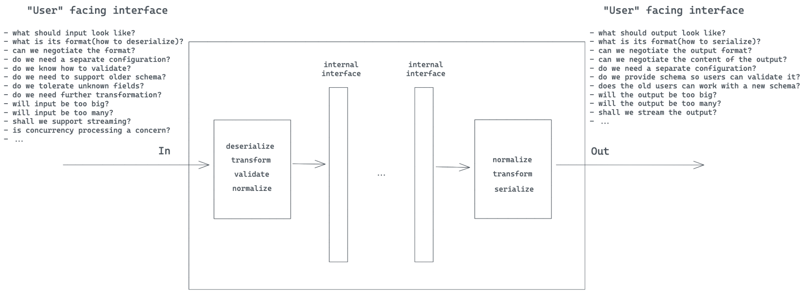
Architecture is about getting interface right
Software Architecture

Slide 20
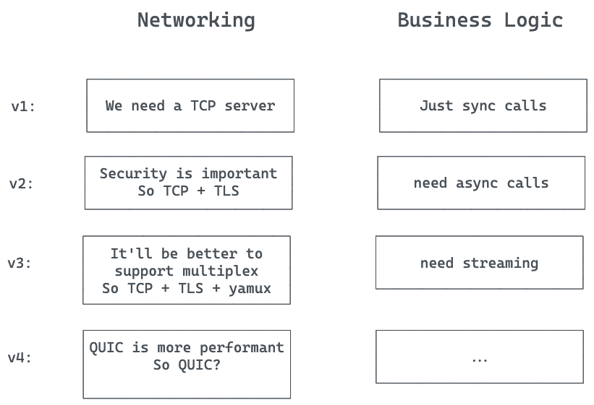
And defer decisions…
Software Architecture
Gather as much information as possible, and think about the potential changes
Separation of Concerns
Build necessary abstractions
generics/trait is your friend

Slide 21
One more thing
what could we potentially leverage deno?

Slide 22
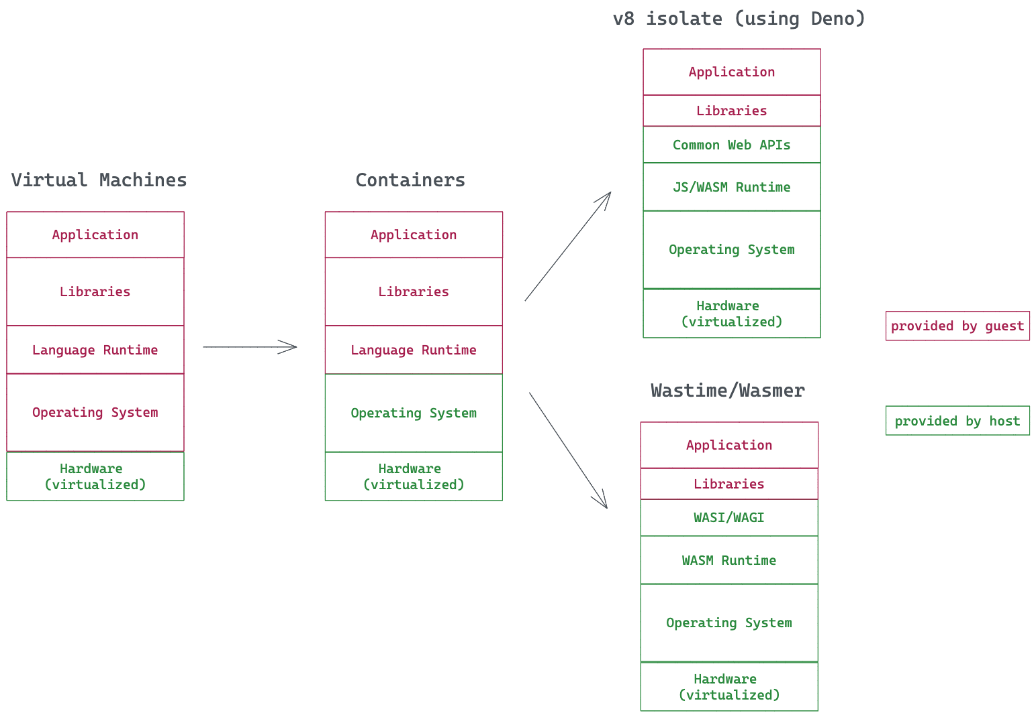
Using deno as a serverless framework
What could we potentially use deno?

Slide 23
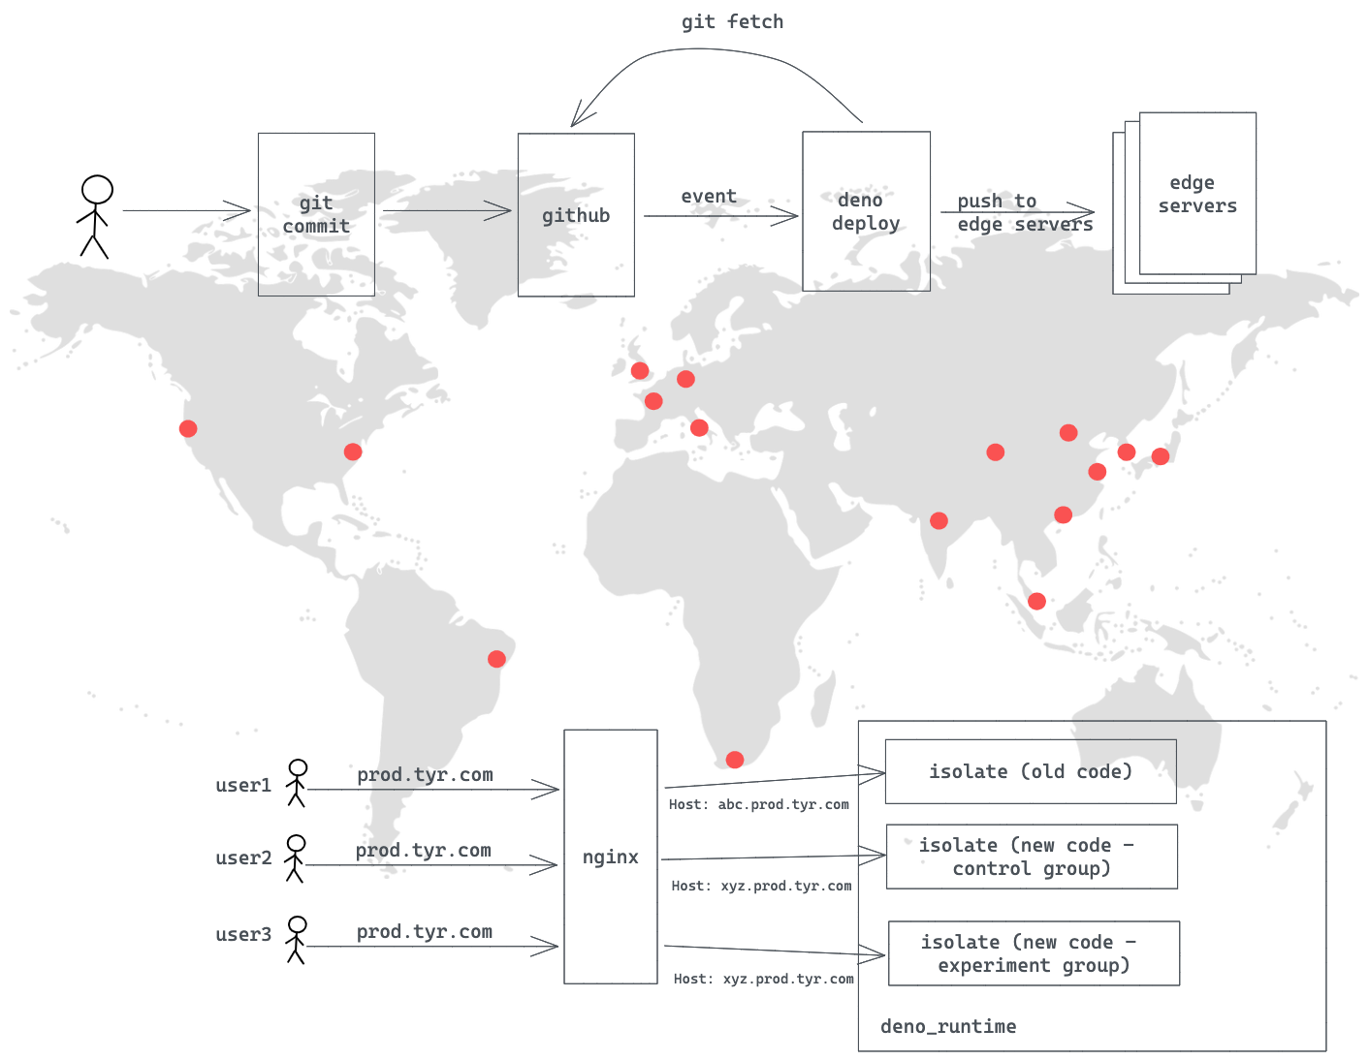
Using deno as a serverless framework
What could we potentially use deno?

